Slide 1
Group Member & Respective Roles
Team Leader: Yiu Hong Sum
Requirement Analysis: Bryan Lim
SDLC: Chen ZhenNi
Implementation: Lim Yan Jun
Design: Deon Tan

Slide 2





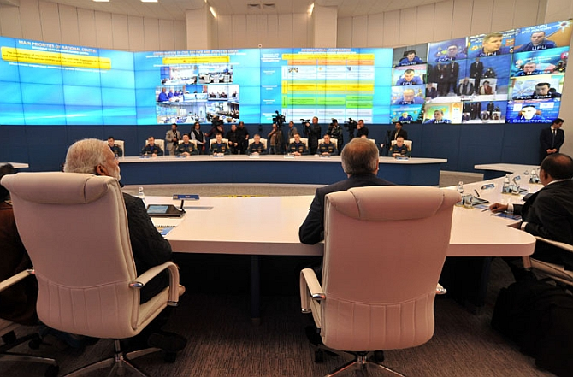

Artist Illustration
911 Supervisor in Classification Team
CMO Liaison Officer
911 Operator
911 API
CMO API
Caller
EF
CMO

Slide 3
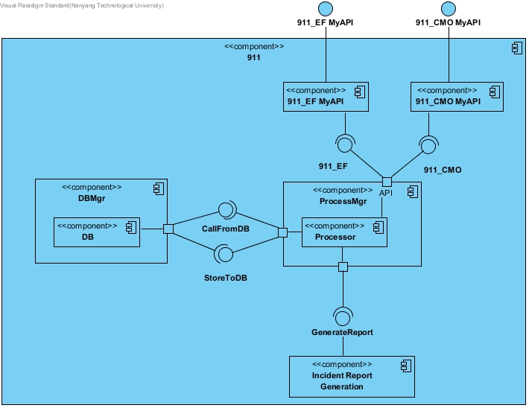
Component diagram

Slide 4
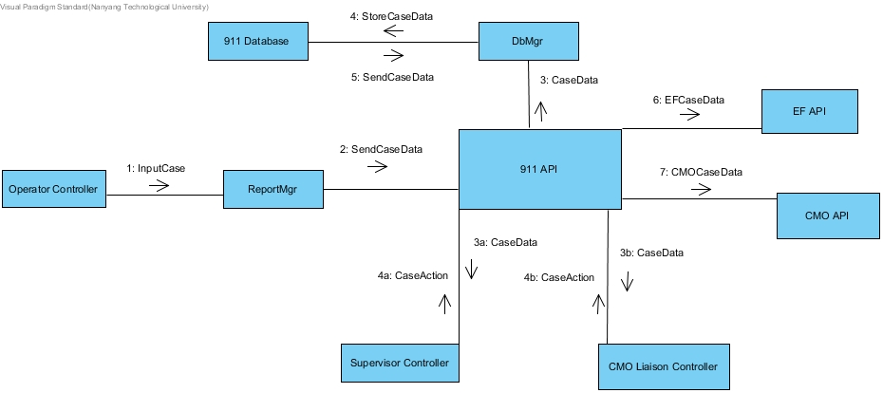
Communication diagram

